Slide 1

Welcome to the
JavaScript Tutorial
The session will start shortly…
Questions? Drop them in the chat. We'll have dedicated moderators answering questions.

Slide 2

Full Stack Web Development Session Housekeeping
The use of disrespectful language is prohibited in the questions, this is a supportive, learning environment for all - please engage accordingly. (Fundamental British Values: Mutual Respect and Tolerance)
No question is daft or silly - ask them!
There are Q&A sessions midway and at the end of the session, should you wish to ask any follow-up questions. Moderators are going to be answering questions as the session progresses as well.
If you have any questions outside of this lecture, or that are not answered during this lecture, please do submit these for upcoming Academic Sessions. You can submit these questions here: Questions

Slide 3
Full Stack Web Development Session Housekeeping cont.
For all non-academic questions, please submit a query: www.hyperiondev.com/support
Report a safeguarding incident: www.hyperiondev.com/safeguardreporting
We would love your feedback on lectures: Feedback on Lectures

Slide 4
Skills Bootcamp
8-Week Progression Overview
Fulfil 4 Criteria to Graduation
✅ Criterion 2: Mid-Course Progress
60 Guided Learning Hours Data Science - 13 tasks
Software Engineering - 13 tasks
Web Development - 13 tasks
Due Date: 28 April 2024
✅ Criterion 1: Initial Requirements
Timeframe: First 2 Weeks
Guided Learning Hours (GLH): Minimum of 15 hours
Task Completion: First four tasks
Due Date: 24 March 2024
Notes:
Graduation from the Skills Boot Camp requires fulfilling four criteria: initial requirements within the first two weeks, mid-course progress by week 4, course progress at the end, and demonstrating employability post-graduation. In order to successfully graduate from the Skills Bootcamp, you'll need to meet four key criteria. The first criterion, covering the initial requirements, must be fulfilled within the first two weeks of the program. This includes a minimum of 15 guided learning hours and the completion of your first four tasks.
The second criterion for mid-course progress has a deadline by week 8, where you are expected to complete a specific number of tasks depending on your track - 60 GLH & 13 Tasks

Slide 5
Skills Bootcamp
Progression Overview
✅ Criterion 3: Course Progress
Completion: All mandatory tasks, including Build Your Brand and resubmissions by study period end
Interview Invitation: Within 4 weeks post-course
Guided Learning Hours: Minimum of 112 hours by support end date
(10.5 hours average, each week)
✅ Criterion 4: Demonstrating Employability
Final Job or Apprenticeship Outcome: Document within 12 weeks post-graduation
Relevance: Progression to employment or related opportunity
Notes:
Moving on, the third criterion involves completing all mandatory tasks and resubmissions by the end of your study period and securing an interview invitation within four weeks post-course. Finally, the fourth criterion focuses on demonstrating employability, which includes documenting a final job outcome within 12 weeks post-graduation.

Slide 6


JavaScript, Iteration, Collections and Debugging
March 2024
Notes:
Welcome to the Grammar Skills Bootcamp Orientation for November 2023. Today, we will cover several important aspects of this program to ensure you have all the information needed for a successful learning experience.

Slide 7
Lecture Overview
Conditionals
While Loops
For Loops
Trace Tables
Stack Traces
Debugging
Handling Strings
Arrays
Maps

Slide 8
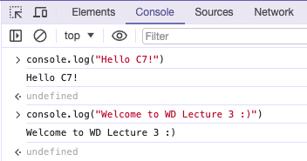
JavaScript
A versatile scripting language utilised in front-end web development and server-side programming.
We use JavaScript with HTML and CSS to transform our static web pages to dynamic web pages.
Last week, we learnt how to link scripts to our HTML. These scripts are written in JavaScript.
Browsers have built-in consoles used to debug JavaScript code.
Notes:
CoGrammar is a leading provider of coding Skills Bootcamps and online courses. Our partnership with HyperionDev brings the latest tech stack expertise and industry insights. Our hands-on, project-based approach is designed to be challenging yet accessible.

Slide 9
JavaScript
The console is useful for debugging and running code snippets.
To create our scripts, we will use Visual Studio Code and Node.js.
The following extensions are also helpful when running your code:
Code Runner: allows you to run JavaScript code in VS Code by pressing Ctrl+Alt+N, right-clicking and pressing “Run Code”, or by pressing the “Play” button.
Open in Browser: allows you to open an HTML file which has been correctly linked to JavaScript scripts in your default browser.
Notes:
CoGrammar is a leading provider of coding Skills Bootcamps and online courses. Our partnership with HyperionDev brings the latest tech stack expertise and industry insights. Our hands-on, project-based approach is designed to be challenging yet accessible.

Slide 10
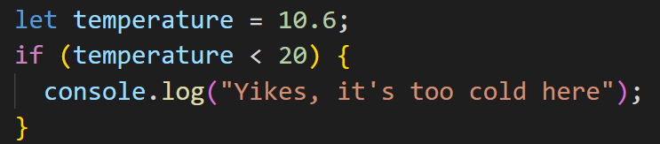
Conditional Statements
Statements that perform different actions depending on whether a condition evaluates to true or false.
Conditional execution is created with the if keyword in JavaScript.
We want some code to be executed if, and only if, a certain condition holds.
The deciding expression is written after the if keyword, between parentheses, followed by the statement to execute.
Notes:
CoGrammar is a leading provider of coding Skills Bootcamps and online courses. Our partnership with HyperionDev brings the latest tech stack expertise and industry insights. Our hands-on, project-based approach is designed to be challenging yet accessible.

Slide 11
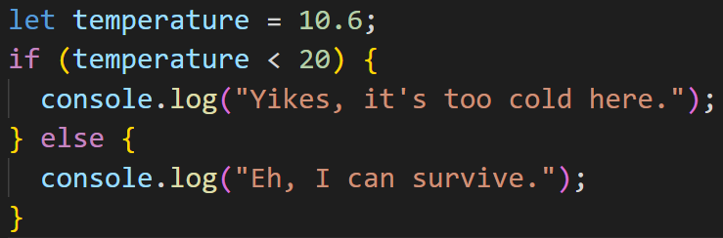
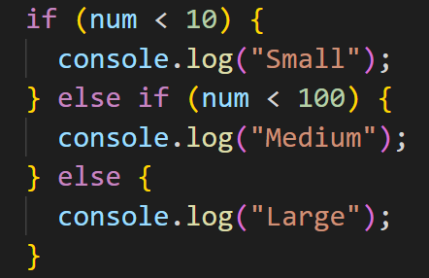
Conditional Statements
You can use the else keyword, together with if, to create two separate, alternative execution paths.
If you have more than two paths to choose from, you can “chain” multiple if/else pairs together.
Notes:
CoGrammar is a leading provider of coding Skills Bootcamps and online courses. Our partnership with HyperionDev brings the latest tech stack expertise and industry insights. Our hands-on, project-based approach is designed to be challenging yet accessible.

Slide 12
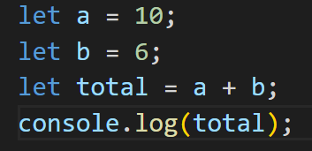
Trace Tables
A technique used to test a program and predict, step-by-step, how the computer will run it.
line | a | b | total | log
1 | 10
2 |  | 6
3 |  |  | 16
4 |  |  |  | 16
Notes:
CoGrammar is a leading provider of coding Skills Bootcamps and online courses. Our partnership with HyperionDev brings the latest tech stack expertise and industry insights. Our hands-on, project-based approach is designed to be challenging yet accessible.

Slide 13
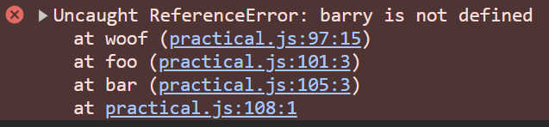
Stack Trace
A detailed report of function calls leading to an error.
Analysing the stack trace helps pinpoint the exact location of the error.
Woof, foo and bar are the functions that were called.
The bottom most line shows the line number where bar was called, it says the function was called at line 108.
From here we can see that bar was called first, which later called the function foo.
After that foo called the function woof. This indicates that the source of the error is woof.
Notes:
CoGrammar is a leading provider of coding Skills Bootcamps and online courses. Our partnership with HyperionDev brings the latest tech stack expertise and industry insights. Our hands-on, project-based approach is designed to be challenging yet accessible.

Slide 14
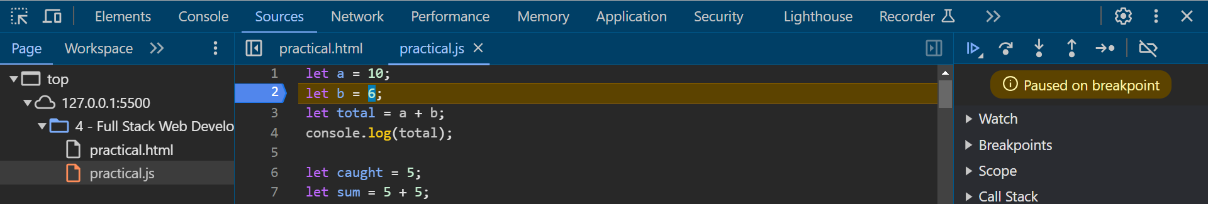
Debugging JavaScript
The process of examining the program, finding the error and fixing it.
You can set breakpoints for JavaScript code in the Sources tab in the Developers tool.
JavaScript will stop executing at each breakpoint and lets you examine the values.
These buttons help you move around the code in debug mode.
Notes:
CoGrammar is a leading provider of coding Skills Bootcamps and online courses. Our partnership with HyperionDev brings the latest tech stack expertise and industry insights. Our hands-on, project-based approach is designed to be challenging yet accessible.

Slide 15

Loops
Often in our code, we need a way to run a piece of code multiple times. This form of control flow is called a loop.
Looping control flow allows us to go back to some point in the program where we were before and repeat it.
Notes:
CoGrammar is a leading provider of coding Skills Bootcamps and online courses. Our partnership with HyperionDev brings the latest tech stack expertise and industry insights. Our hands-on, project-based approach is designed to be challenging yet accessible.

Slide 16
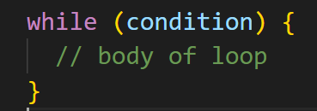
While Loops
The screenshot below shows the syntax of while loops.
While loops are used when you need to repeat your code until a certain condition is met.
We can use trace tables to help us test our loops and evaluate how the computer will run the code, line by line.
Notes:
CoGrammar is a leading provider of coding Skills Bootcamps and online courses. Our partnership with HyperionDev brings the latest tech stack expertise and industry insights. Our hands-on, project-based approach is designed to be challenging yet accessible.

Slide 17
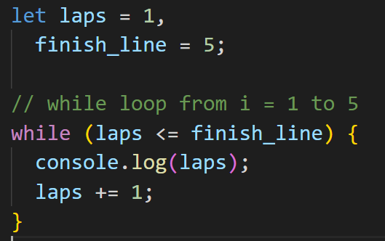
While Loops
laps | finish_line | laps <= finish_line | Output
1 | 5 | true | Print 1
2 | 5 | true | Print 2
3 | 5 | true | Print 3
4 | 5 | true | Print 4
5 | 5 | true | Print 5
6 | 5 | false | Stop
Notes:
CoGrammar is a leading provider of coding Skills Bootcamps and online courses. Our partnership with HyperionDev brings the latest tech stack expertise and industry insights. Our hands-on, project-based approach is designed to be challenging yet accessible.

Slide 18
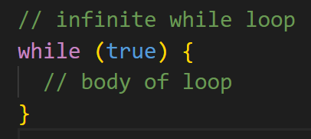
Infinite While Loops
If the condition of a loop is always true, the loop runs for infinite times.
Notes:
CoGrammar is a leading provider of coding Skills Bootcamps and online courses. Our partnership with HyperionDev brings the latest tech stack expertise and industry insights. Our hands-on, project-based approach is designed to be challenging yet accessible.

Slide 19
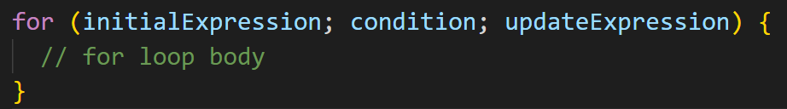
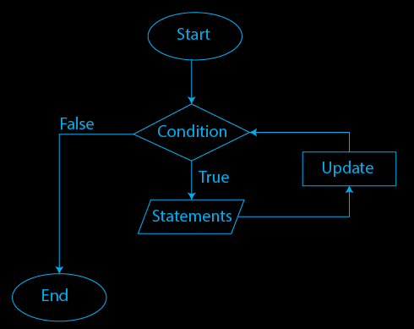
For Loops
The screenshot below shows the syntax of for loops.
For loops are used when we need to repeat our code a set number of times.
Notes:
CoGrammar is a leading provider of coding Skills Bootcamps and online courses. Our partnership with HyperionDev brings the latest tech stack expertise and industry insights. Our hands-on, project-based approach is designed to be challenging yet accessible.

Slide 20
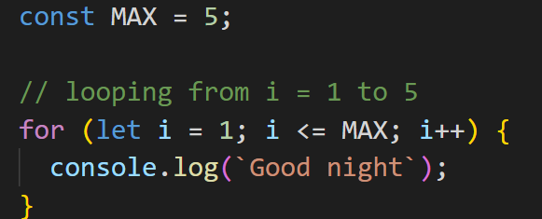
For Loops
i | MAX | i <= MAX | Action
1 | 5 | true | Print
2 | 5 | true | Print
3 | 5 | true | Print
4 | 5 | true | Print
5 | 5 | true | Print
6 | 5 | false | Stop
Notes:
CoGrammar is a leading provider of coding Skills Bootcamps and online courses. Our partnership with HyperionDev brings the latest tech stack expertise and industry insights. Our hands-on, project-based approach is designed to be challenging yet accessible.

Slide 21
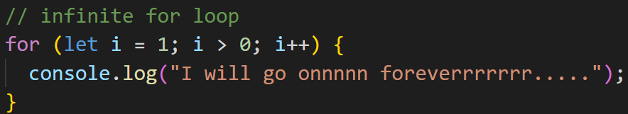
Infinite For loop
If the test condition in a for loop is always true, it runs forever (until memory is full).
Notes:
CoGrammar is a leading provider of coding Skills Bootcamps and online courses. Our partnership with HyperionDev brings the latest tech stack expertise and industry insights. Our hands-on, project-based approach is designed to be challenging yet accessible.

Slide 22
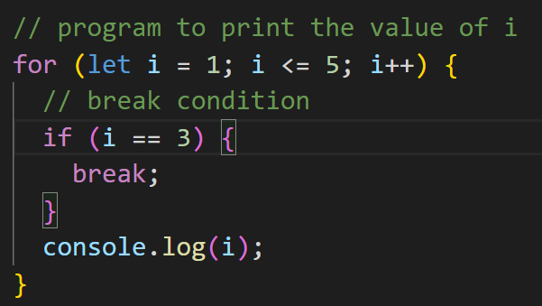
Break Statement
The break statement is used to terminate the loop immediately when it is encountered.
You can run a break statement by using the break keyword.
This works for both while and for loops.
Notes:
CoGrammar is a leading provider of coding Skills Bootcamps and online courses. Our partnership with HyperionDev brings the latest tech stack expertise and industry insights. Our hands-on, project-based approach is designed to be challenging yet accessible.

Slide 23
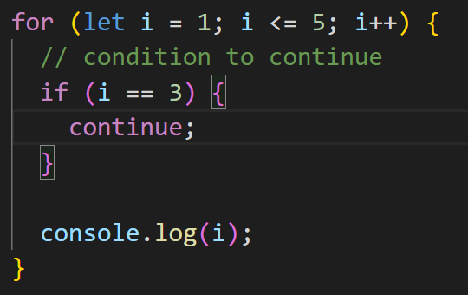
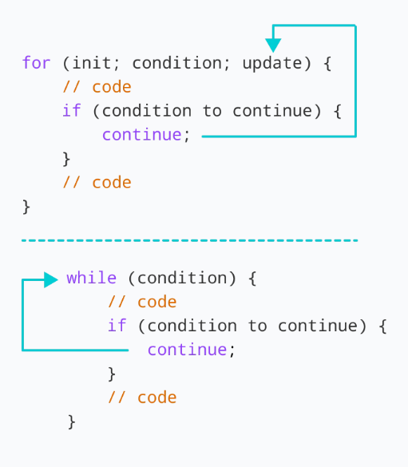
Continue Statement
The continue statement is used to skip the current iteration of the loop and the control flow of the program goes to the next iteration.
This works for both while and for loops.
Notes:
CoGrammar is a leading provider of coding Skills Bootcamps and online courses. Our partnership with HyperionDev brings the latest tech stack expertise and industry insights. Our hands-on, project-based approach is designed to be challenging yet accessible.

Slide 24
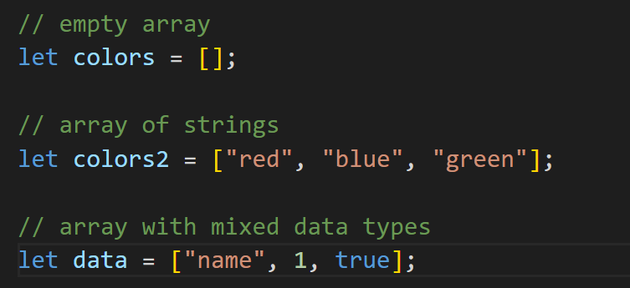
Arrays
An array is a data structure that can store multiple values at once.
We can create an array by placing elements inside an array literal [ ], separated by commas.
Notes:
CoGrammar is a leading provider of coding Skills Bootcamps and online courses. Our partnership with HyperionDev brings the latest tech stack expertise and industry insights. Our hands-on, project-based approach is designed to be challenging yet accessible.

Slide 25
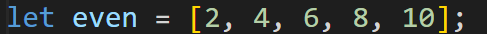
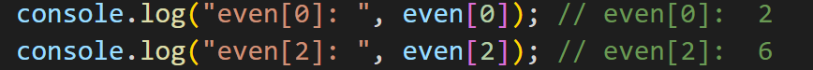
Arrays
Each element of an array is associated with a number called an index.
The index specifies the position of the element inside the array.
We can use an array index to access the elements of the array.
Index | 0 | 1 | 2 | 3 | 4
 | 2 | 4 | 6 | 8 | 10
Notes:
CoGrammar is a leading provider of coding Skills Bootcamps and online courses. Our partnership with HyperionDev brings the latest tech stack expertise and industry insights. Our hands-on, project-based approach is designed to be challenging yet accessible.

Slide 26
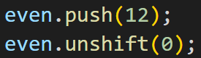
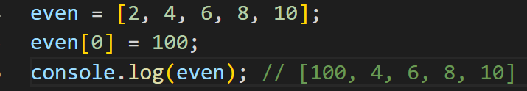
Arrays
We can add elements to an array using built-in methods like push() and unshift().
The push() method adds an element at the end of the array.
The unshift() method adds an element at the beginning.
We can add or change elements by accessing the index value.
Notes:
CoGrammar is a leading provider of coding Skills Bootcamps and online courses. Our partnership with HyperionDev brings the latest tech stack expertise and industry insights. Our hands-on, project-based approach is designed to be challenging yet accessible.

Slide 27
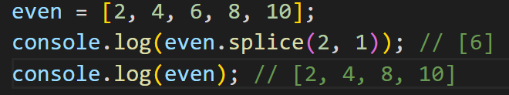
Arrays
We can remove (and add) an element from any specified index of an array using the splice() method.
The arguments are: (position, howManyToRemove, itemsToAdd..)
Notes:
CoGrammar is a leading provider of coding Skills Bootcamps and online courses. Our partnership with HyperionDev brings the latest tech stack expertise and industry insights. Our hands-on, project-based approach is designed to be challenging yet accessible.

Slide 28
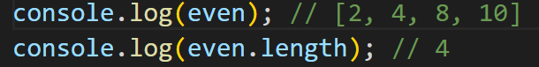
Arrays
We can find the length of an array using the length property.
Notes:
CoGrammar is a leading provider of coding Skills Bootcamps and online courses. Our partnership with HyperionDev brings the latest tech stack expertise and industry insights. Our hands-on, project-based approach is designed to be challenging yet accessible.

Slide 29
Maps

Slide 30
Maps
The optional argument to the Map() constructor should be an iterable object that yields two element [key, value] arrays.
In practice, this means that if you want to initialize a map when you create it, you’ll typically write out the desired keys and associated values as an array of arrays.
Notes:
CoGrammar is a leading provider of coding Skills Bootcamps and online courses. Our partnership with HyperionDev brings the latest tech stack expertise and industry insights. Our hands-on, project-based approach is designed to be challenging yet accessible.

Slide 31
Maps
In addition to get() and set(),
use has() to check whether a map includes the specified key
use delete() to remove a key (and its associated value) from the map
use clear() to remove all key/value pairs from the map
use the size property to find out how many keys a map contains
Notes:
CoGrammar is a leading provider of coding Skills Bootcamps and online courses. Our partnership with HyperionDev brings the latest tech stack expertise and industry insights. Our hands-on, project-based approach is designed to be challenging yet accessible.

Slide 32
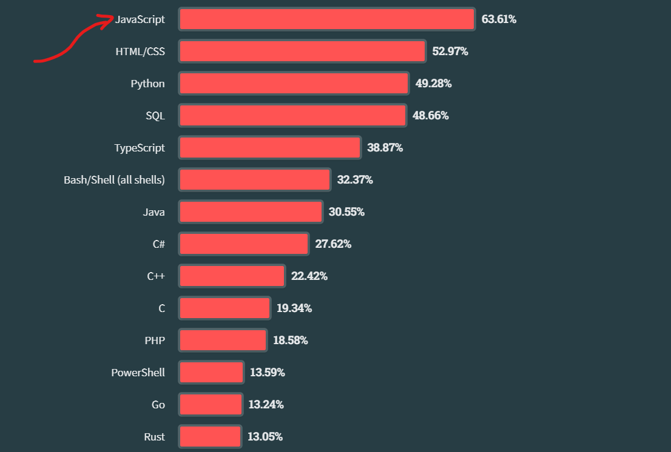
Facts (Programming Language)
StackOverflow Dev Survey
Notes:
CoGrammar is a leading provider of coding Skills Bootcamps and online courses. Our partnership with HyperionDev brings the latest tech stack expertise and industry insights. Our hands-on, project-based approach is designed to be challenging yet accessible.

Slide 33
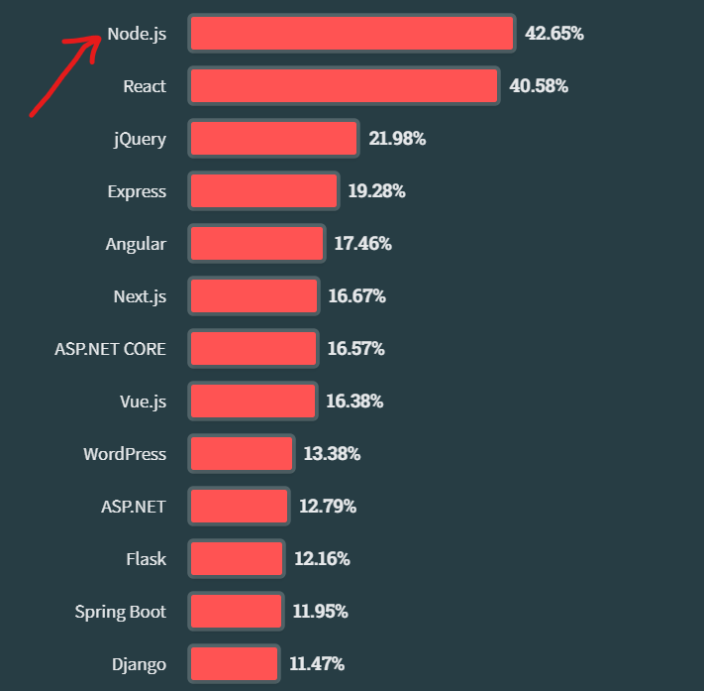
Facts (Frameworks)
StackOverflow Dev Survey
Notes:
CoGrammar is a leading provider of coding Skills Bootcamps and online courses. Our partnership with HyperionDev brings the latest tech stack expertise and industry insights. Our hands-on, project-based approach is designed to be challenging yet accessible.

Slide 34
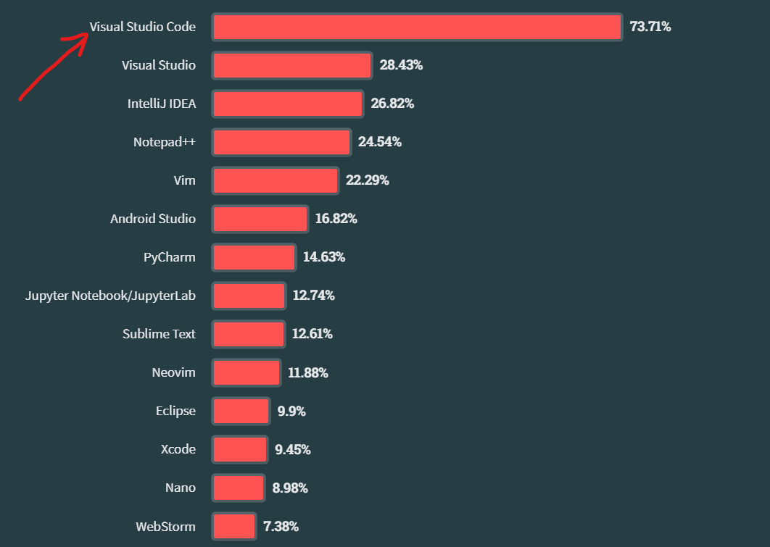
Facts (IDE)
StackOverflow Dev Survey
Notes:
CoGrammar is a leading provider of coding Skills Bootcamps and online courses. Our partnership with HyperionDev brings the latest tech stack expertise and industry insights. Our hands-on, project-based approach is designed to be challenging yet accessible.

Slide 35
Resources
JavaScript Documentation
https://developer.mozilla.org/en-US/docs/Web/JavaScript
https://devdocs.io/javascript/
https://www.w3schools.com/jsrEF/default.asp
StackOverflow Developer Survey
https://survey.stackoverflow.co/2023/#technology-most-popular-technologies
NodeJS
https://nodejs.org/en/download
StackOverflow Dev Survey
Notes:
CoGrammar is a leading provider of coding Skills Bootcamps and online courses. Our partnership with HyperionDev brings the latest tech stack expertise and industry insights. Our hands-on, project-based approach is designed to be challenging yet accessible.

Slide 36
Questions and
Answers

Slide 37

Thank you for attending

